Slide 1


VISVESVARAYA TECHNOLOGICAL UNIVERSITY
“Jnana Sangama”, Belagavi– 590018

Slide 2

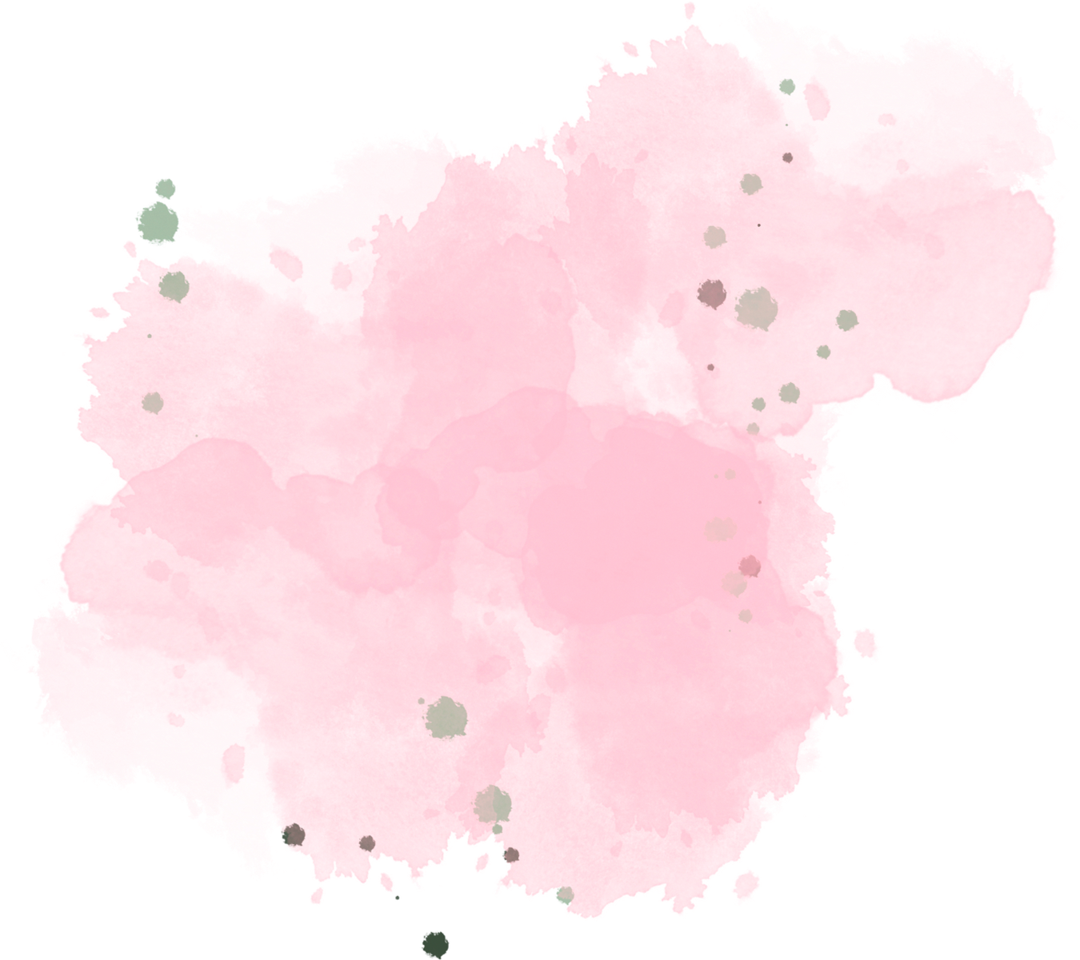


SELECTION
TREE

Slide 3
The Selection tree is a complete binary tree with n external nodes and n – 1 internal nodes.
The external nodes represent the players, and the internal nodes are representing the winner of the match between the two players.

Slide 4

A selection tree or tournament tree is a tree data structure
It selects a winner in a knockout tournament
The leaves of the tree represent n players entering the tournament

Slide 5

There are 2 types in Selection trees
WINNER
TREE
LOSER
TREE

Slide 6
WINNER TREE
In a tournament tree, when the internal nodes represent the winner of the match, the tree obtained is referred to as the winner tree.
Each internal node stores either the smallest or greatest of its children, depending on the winning criteria.

Slide 7
When the winner is the smaller value then the winner tree is referred to as the minimum winner tree
When the winner is the larger value, then the loser tree is referred to as the maximum winner tree.
The tournament's winner is always the smallest or the greatest of all the players or values

Slide 8

Lets take an example:
Eight players participate in a tournament where a number represents each player, from 1 to 8. The pairings of these players are given below:

Slide 9
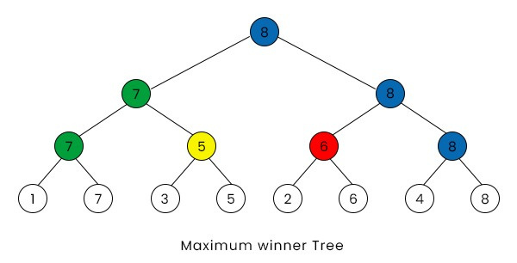
Here,the value of all the parents is either equal to or larger than its children, and the winner is 8, which is the largest of all the players.

Slide 10
LOSER TREE
In a tournament tree, when the internal nodes are used to represent the loser of the match between two, then the tree obtained is referred to as the loser tree.
When the loser is the smaller value then the loser tree is referred to as the minimum loser tree
When the loser is the larger value, then the loser tree is referred to as the maximum loser tree.

Slide 11
Let’s take an example:
Eight players participate in a tournament where a number represents each player, from 1 to 8. The pairings of these players are given below:

Slide 12
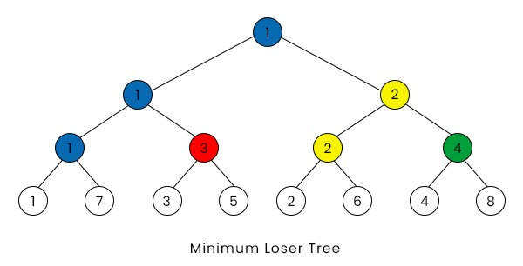
Here, the value of the parent is either smaller or equal to its children, and 1 is the overall loser of the tournament.

Slide 13
Applications of a tournament tree:
It can find the maximum or minimum value in an array.
It is generally used in sorting.
It is used to find the median of the sorted array
It is also used in the truck loading problem
(Consumes more time)

Slide 14
Conclusion
In conclusion, both Winner and Loser Trees are powerful data structures used in algorithms for efficient selection operations.
Winner Trees facilitate the retrieval of the maximum element, while Loser Trees excel at finding the minimum element among a dynamic set of competitors.
These tree structures offer logarithmic time complexity for selection operations, making them invaluable in various applications such as priority queues, external sorting, and tournament-style algorithms.
By efficiently organizing and comparing elements, Winner and Loser Trees significantly enhance the performance of algorithms requiring fast access to extremal values within a collection.

